Slide 1

Introduction to Robotics
CSE 461
Lecture 4 : Chapter 1(Introduction to robotics: basics)
Md Toki Tahmid
Lecturer, Dept. of Computer Science and Engineering
Brac University

Slide 2
Previous Class
Recognition Subsystem
Control Subsystem

Slide 3
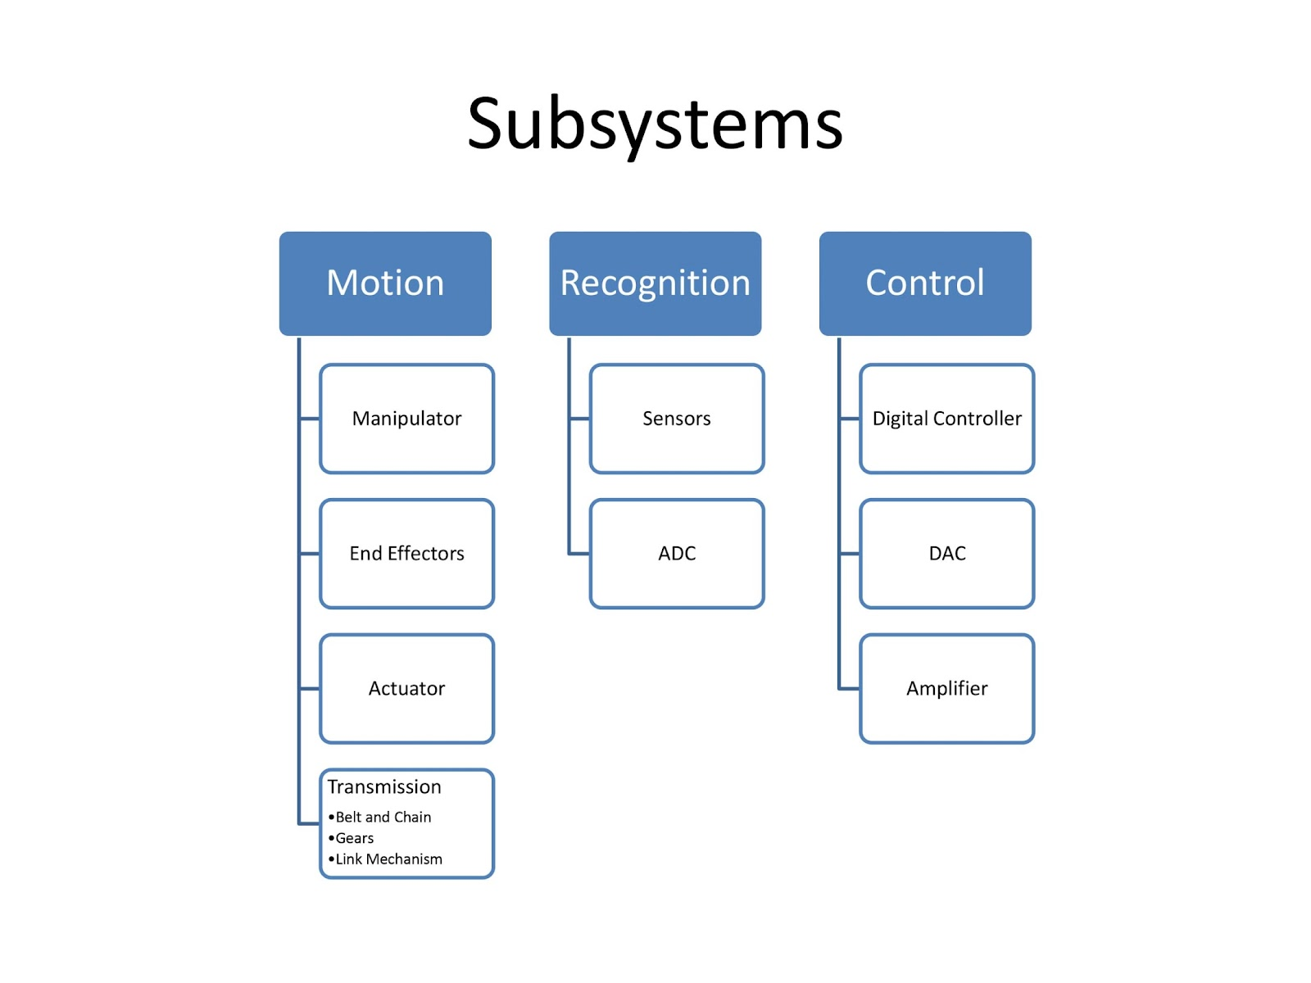

Slide 4
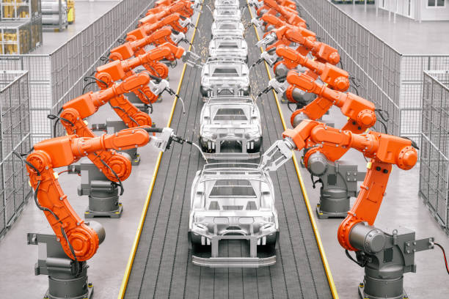

Slide 6
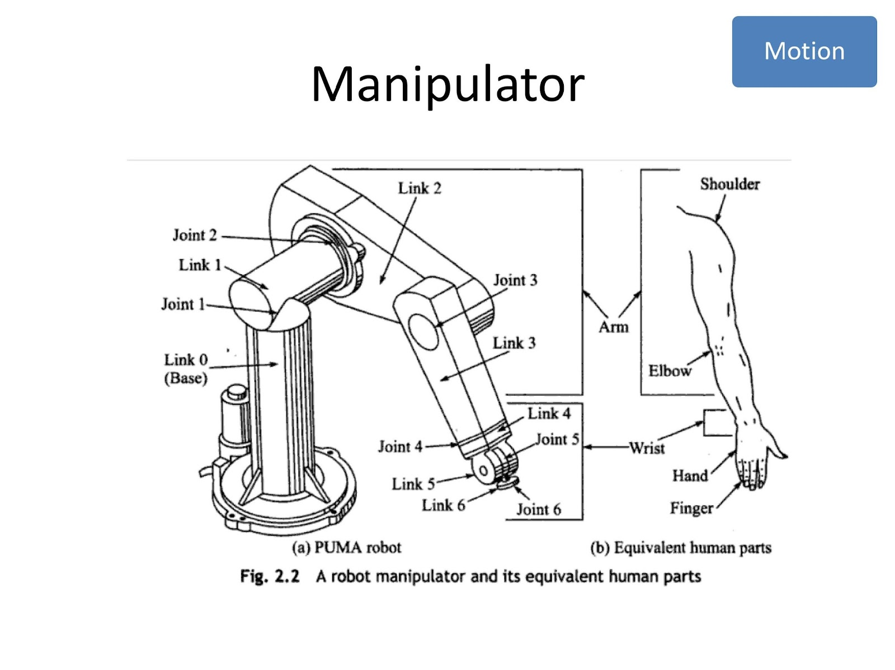

Slide 7
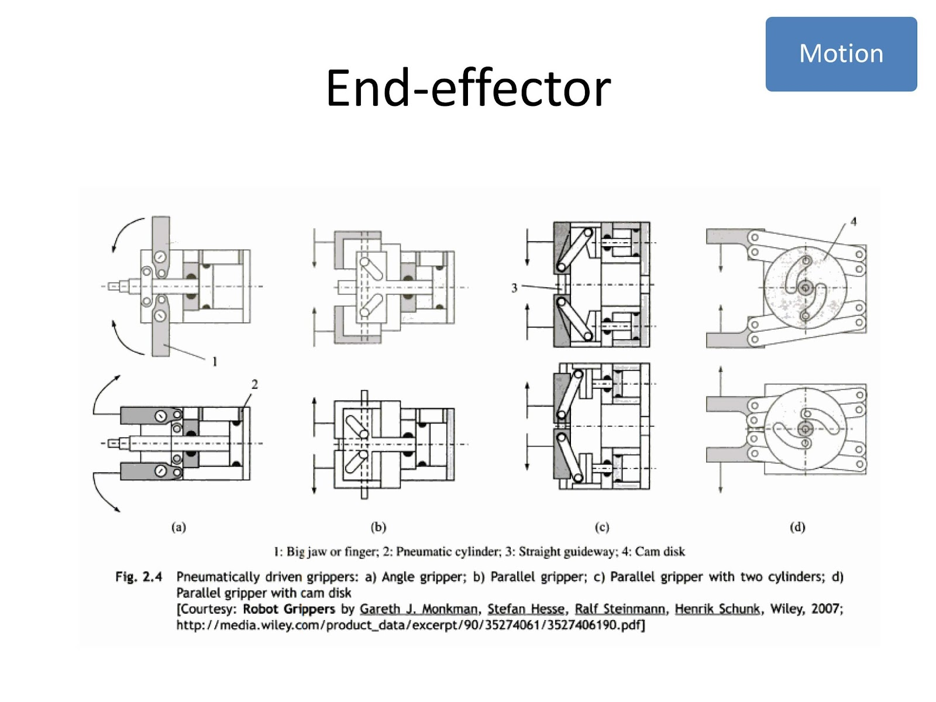

Slide 8
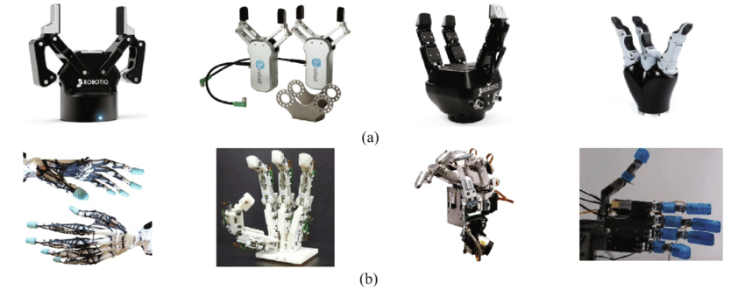
End Effector
Two types of fingered end-effectors: (a) gripper type, (b) anthropomorphic type

Slide 9
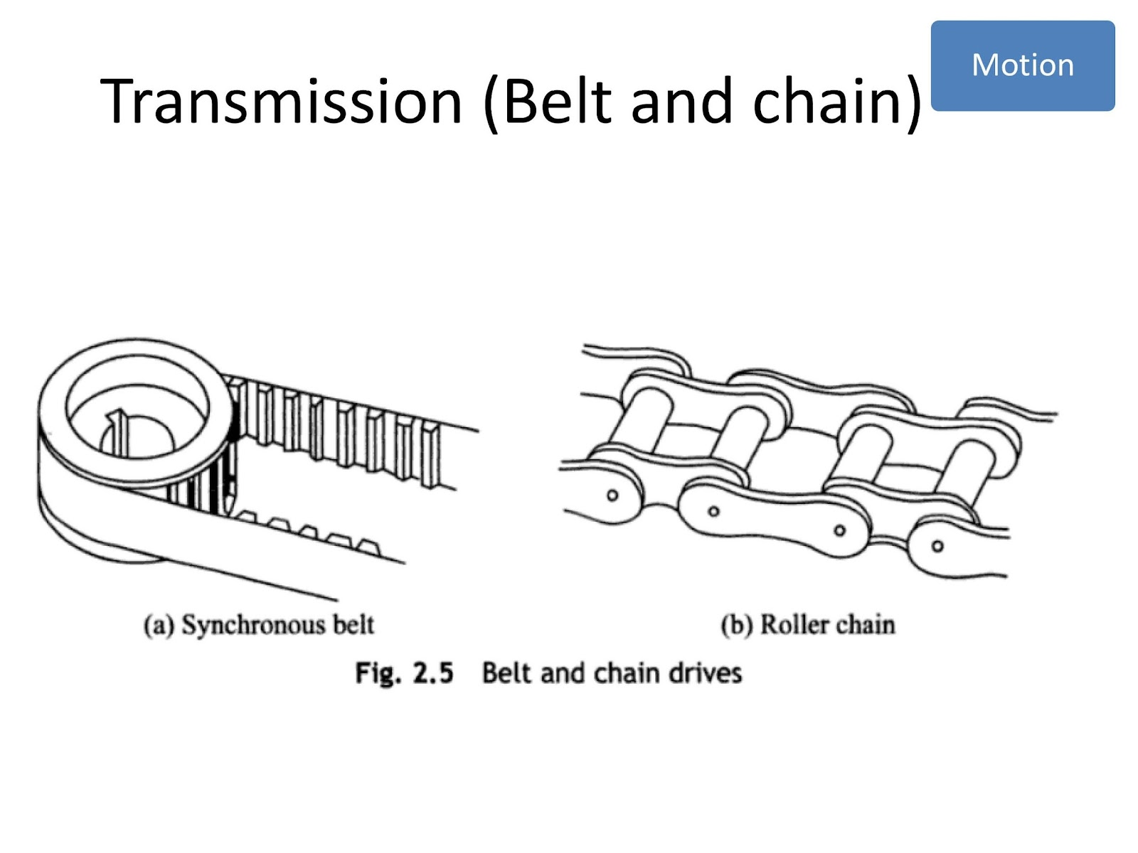

Slide 10
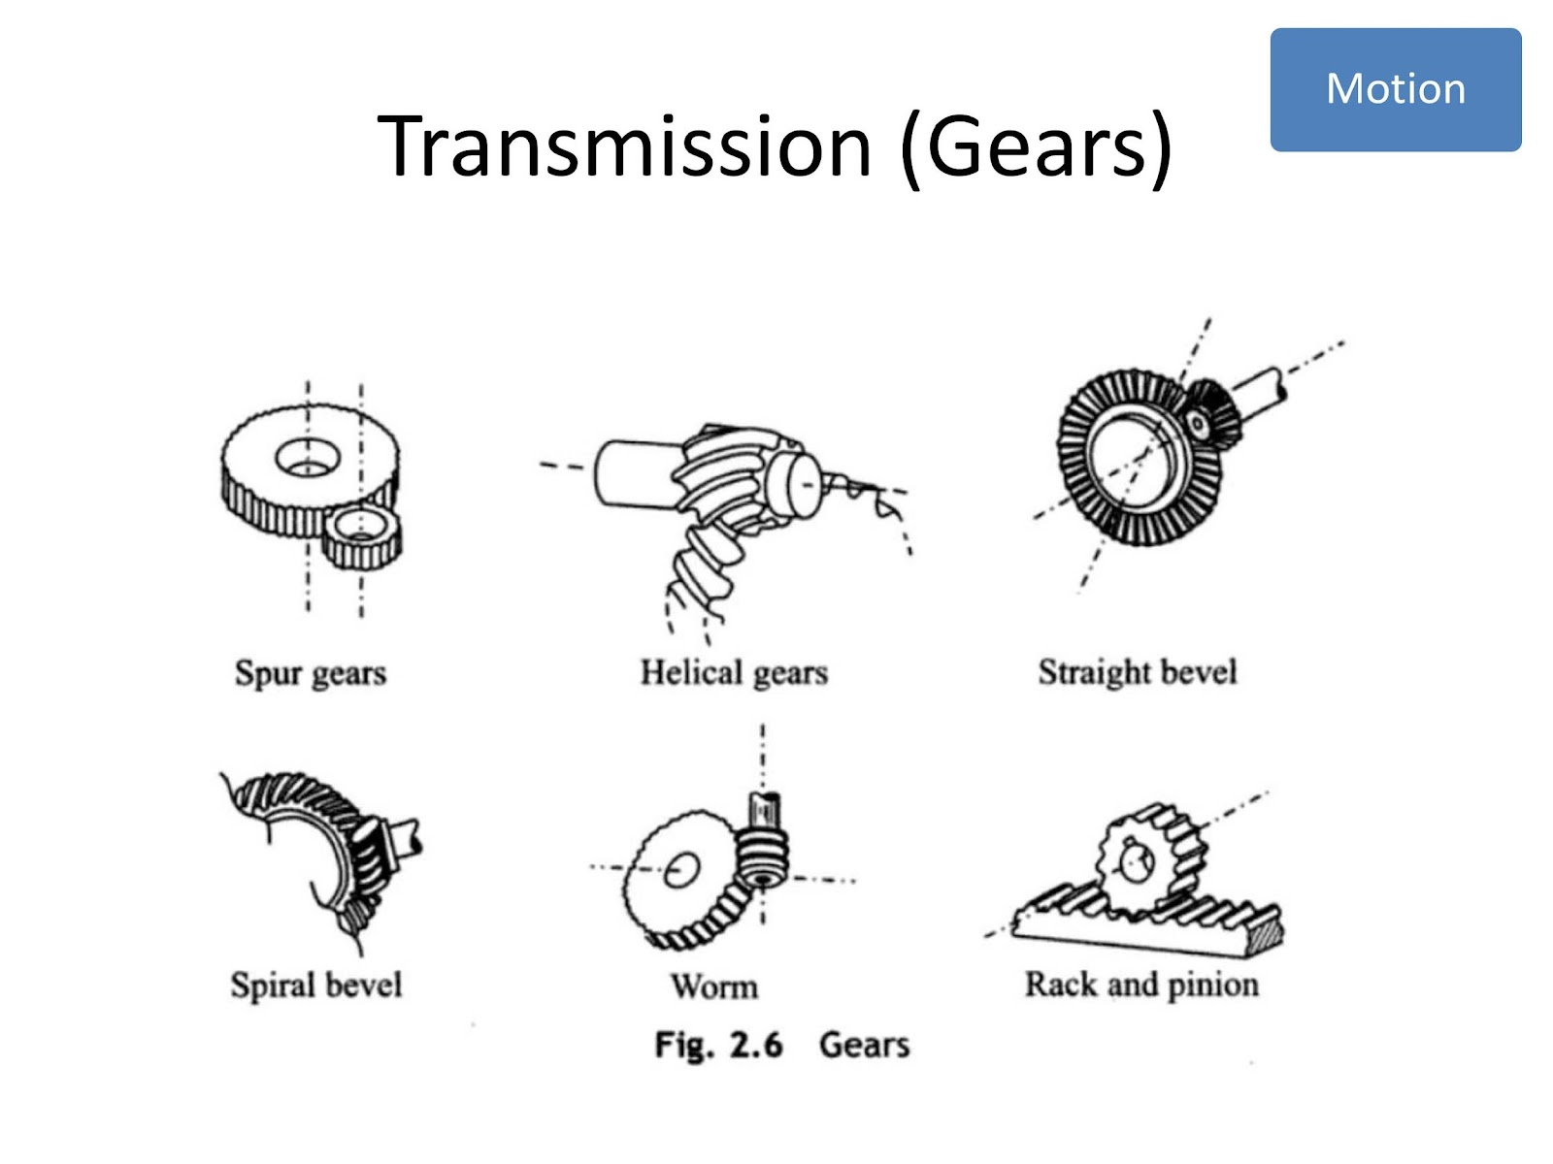

Slide 11
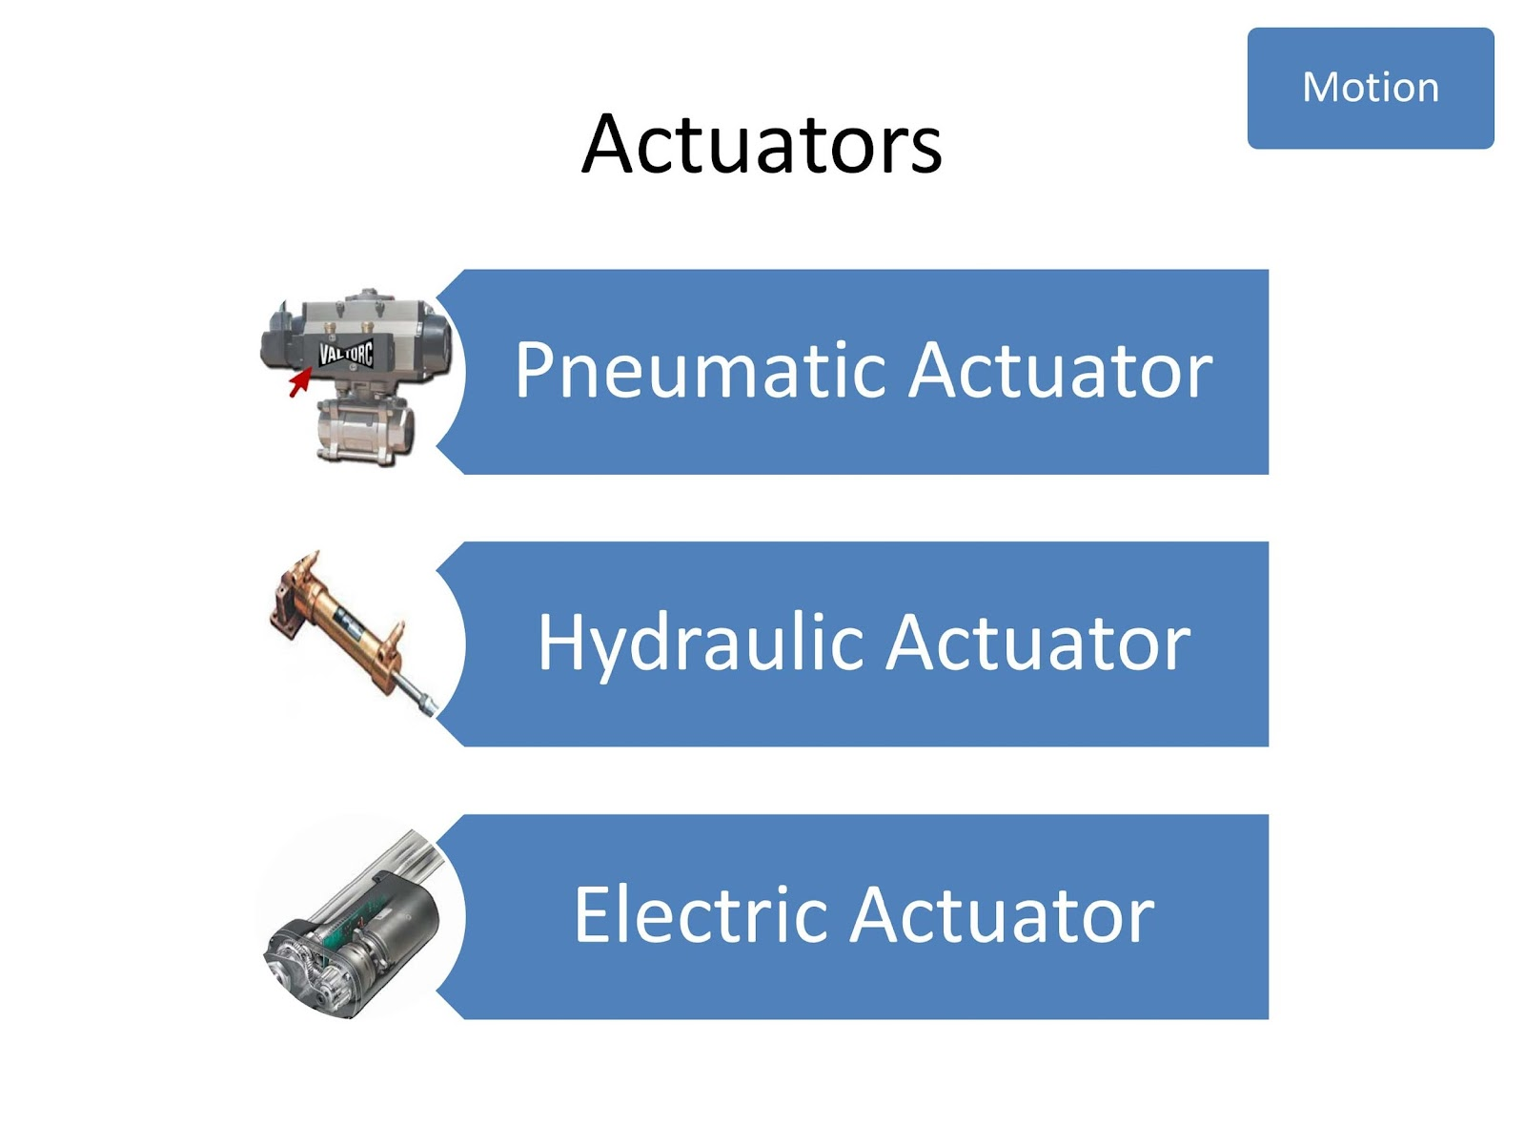

Slide 12
Pneumatic

Slide 13
Hydraulic

Slide 14
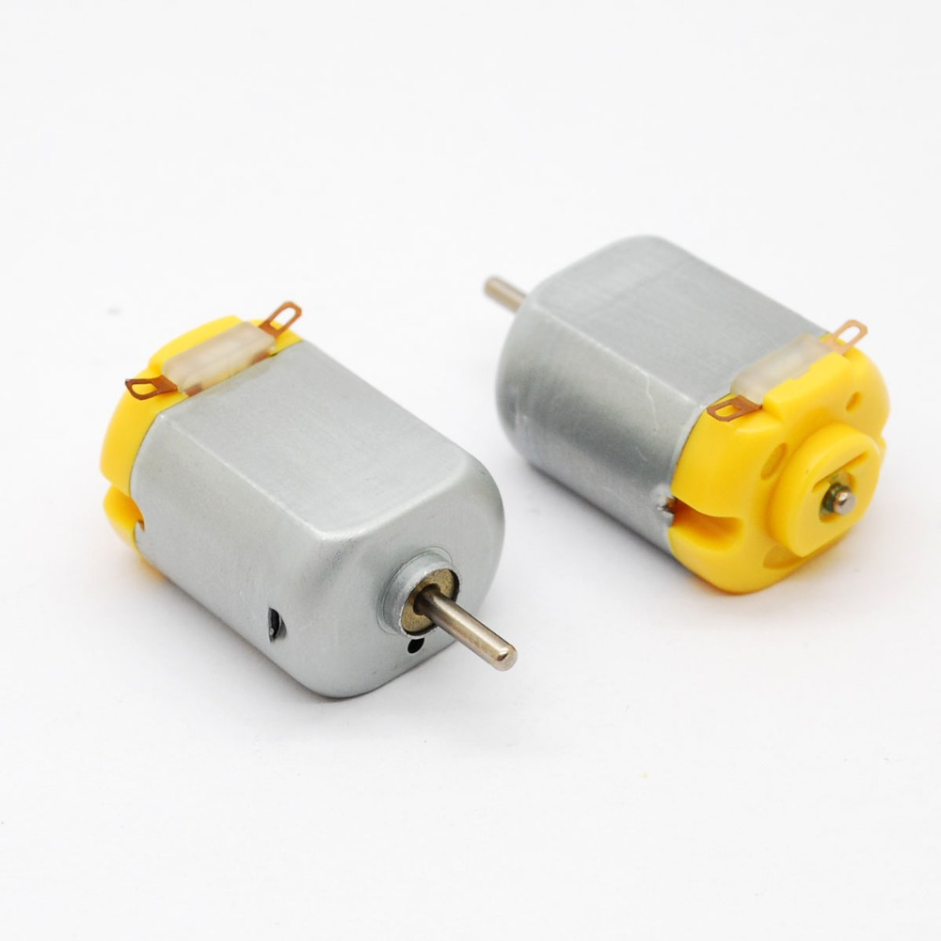
Electric

Slide 15
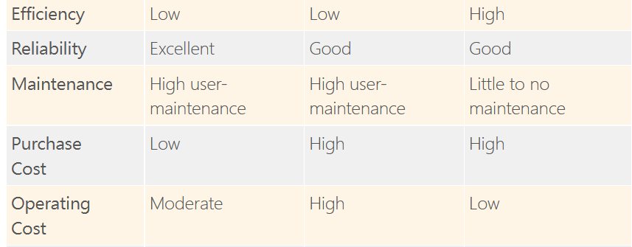

Slide 16
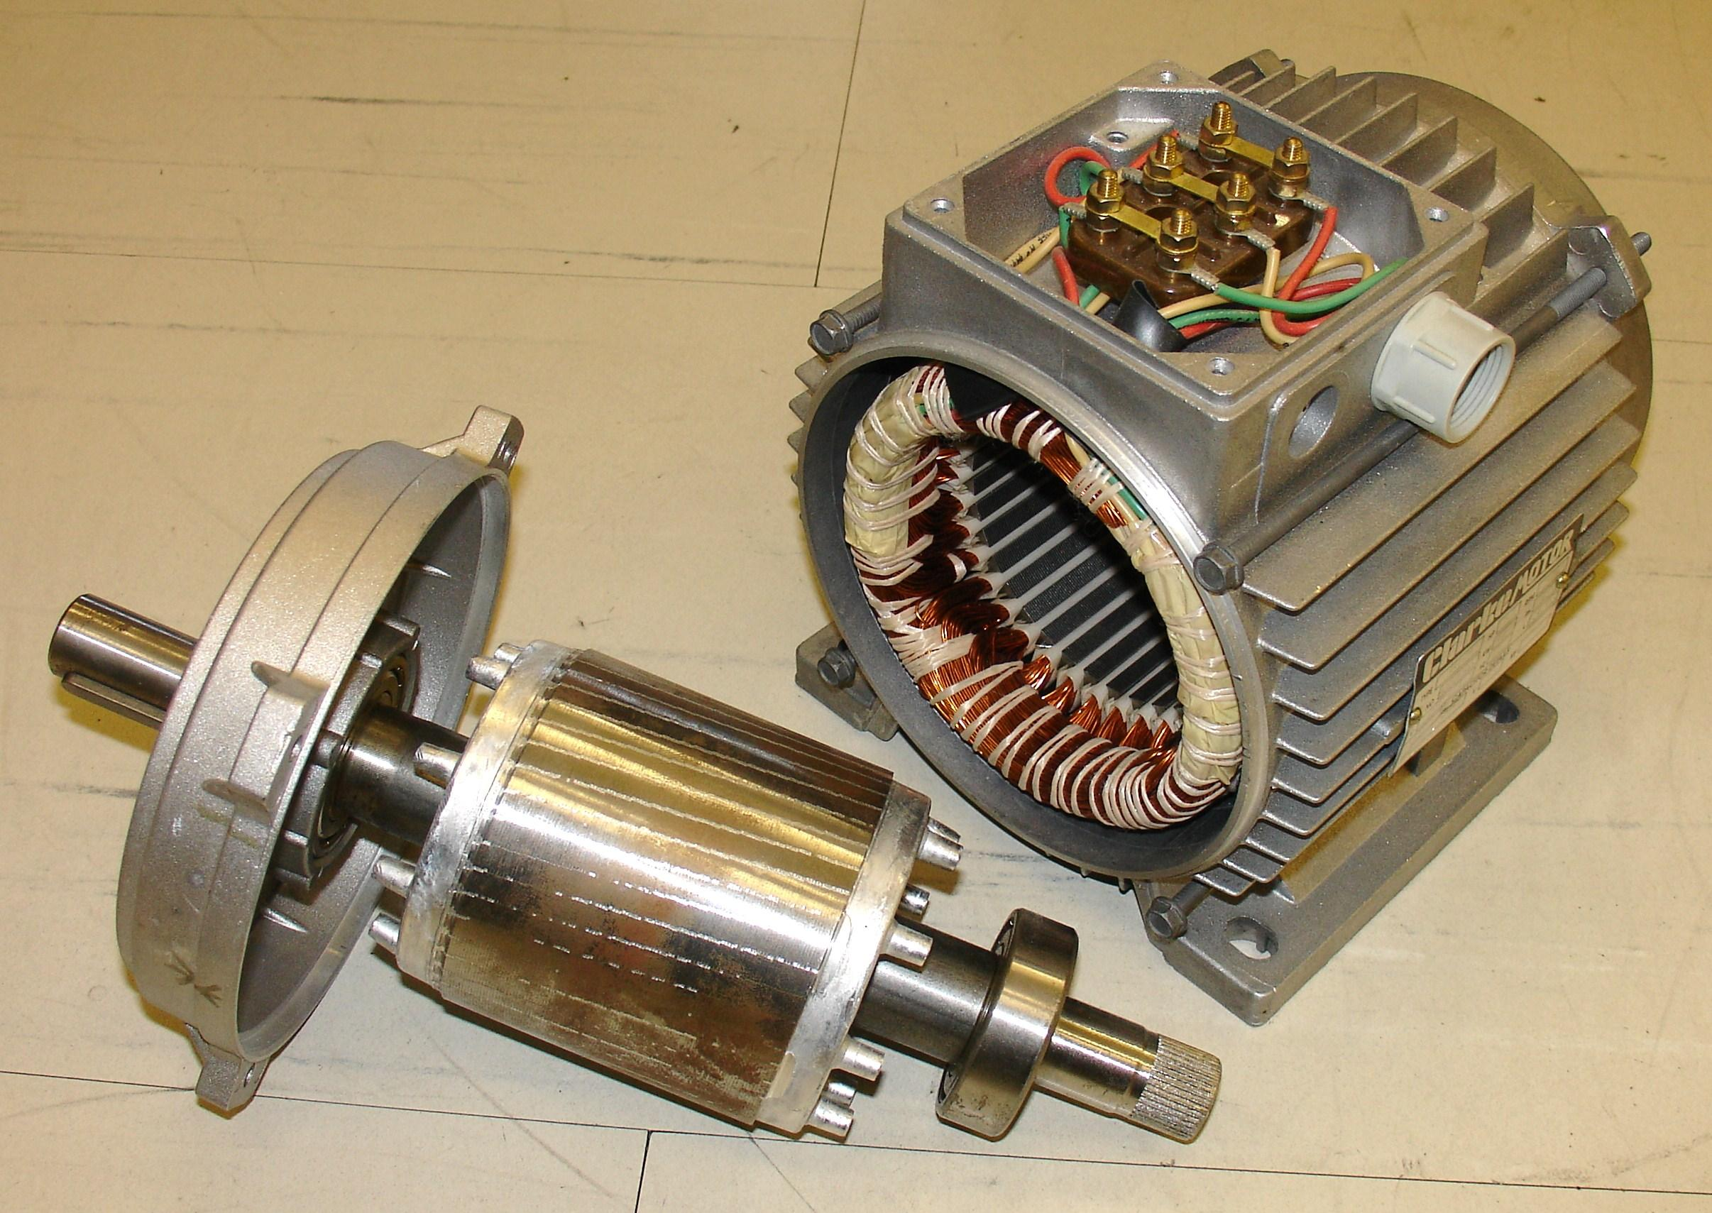
Motor
Stator
Rotor

Slide 17
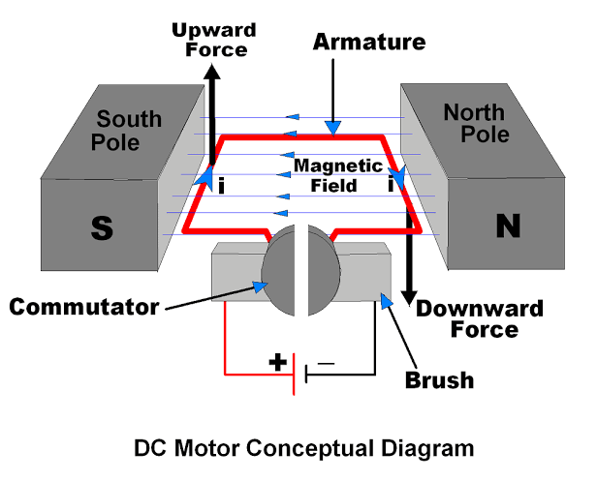
DC motor
https://youtu.be/LAtPHANEfQo

Slide 18
DC motor
https://youtu.be/LAtPHANEfQo

Slide 19
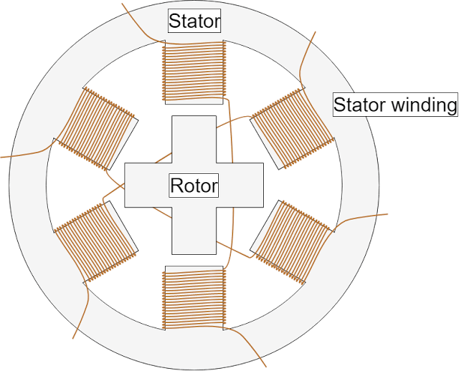
Stepper Motor
https://youtu.be/eyqwLiowZiU

Slide 20
Stepper Motor
https://youtu.be/eyqwLiowZiU

Slide 21
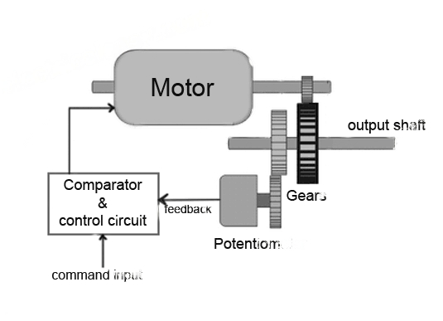
Servo Motor

Slide 22
Next Class
Quiz

Slide 23
Thank You

